Slide 1
Extended ER Presentation EBAY
Group2:
Kaushik M Rao
Viraj Patel
Sahil
Pavan
Manthan Kothari

Slide 2
Contents
Introduction
Advantages of Business Model
High Level Data Model
Our Approach
Entity Relationship Model
Graphical representation
Data Model
Business Rules
E-Commerce Business Models
Types of E-commerce businesses
Contract for Purchasing a Product
Model
Contract for delivery of order
Model
Contract for Purchasing a new Service
Model
Conclusion

Slide 3
INTRODUCTION
eBay is an online website. It is a place for online auctions. Anybody can sell almost anything they want there. People can buy many things there as well.
People have to send what they sell themselves, usually using mail. Some items may be
collected by the buyer such as items to large or heavy to post. Buyers can transfer the
money in any way they want as long as the sellers accept payments made that way
It also offers services like online money transfers as part of its services PayPal, online
classified advertisements (via Kijiji, or eBay Classifieds Group); and online event ticket
trading (via StubHub).

Slide 4
Advantages of eBay Business model
Reselling: We can literally sell anything on ebay. Seller can resell the items on eBay at a higher per-unit price than he paid.
●
Drop shopping: is a form of retail business wherein the seller accepts customer orders but does not keep goods sold in stock. Instead, in a form of supply chain management, it transfers the orders and their shipment details to either the manufacturer, a wholesaler, another retailer, or a fulfilment house, which then ships the goods directly to the customer.

Slide 5
Advantages Continued:
Wholesaling: Seller and buyer can sell and buy items on bulk on ebay.
Liquification: generally, refers to the process of selling off a company's inventory, typically at a big discount, to generate cash. In most cases, a liquidation sale is a precursor to a business closing.
Retail arbitrage is an ecommerce business model centered around buying inventory at a discount from offline and online retailers, then reselling it online for a profit.

Slide 6
High Level Data Model
Customer
Order
Product
Shipment

Slide 7
HLDM – high level data model showing several high level entities
Customer - When a customer enters an E-commerce website they will look for the products they would like to purchase.
A customer will select and put the product in the Cart and then continue to the purchase tab.
Product - The product is put for sale by multiple different stores, listed with a description, ratings, details, measurements, features, and price.
The product will have a product ID that will be added to cart and uploaded to the invoice, which once paid, will bring upon the product shipping ID and status

Slide 8
Order - Ecommerce fulfilment refers to the full process of getting a customer's order delivered once they place it online. Receiving and storing goods, processing orders, picking things, packing boxes, and conveying the items to the customer's shipping address are all part of this supply chain. destination.
Ecommerce shipping refers to all of the services required to transfer things ordered online from a retailer to the customer's delivery address. Ecommerce shipping may be reasonable, economical, and quick with the proper partner.

Slide 9
Our Approach
Our Approach has three Steps :-
Establish the Scope of the Database
Identify the 'Things of Interest' that are within the Scope, (called
Entities).
Determine the Relationships between them.
At the end of this presentation, we have will produced a diagram of the Database Design, which is commonly referred as an 'Entity-Relationship Diagram', or ERD

Slide 10
Entities Taken into Consideration
➢
Customers
Customer Payment Method
➢
Orders
Payments
➢
Products
Shipments
➢
Product Types
Shipment Items
➢
Order Items
➢
Order Status Code
➢
Order Item Status Code
➢
Invoices
➢
Invoice Status Code
➢
Reference Payment Method

Slide 11
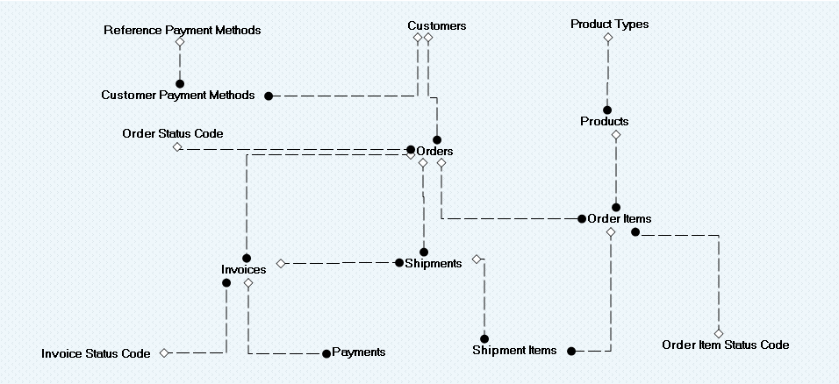
Entity Relationship Model

Slide 12
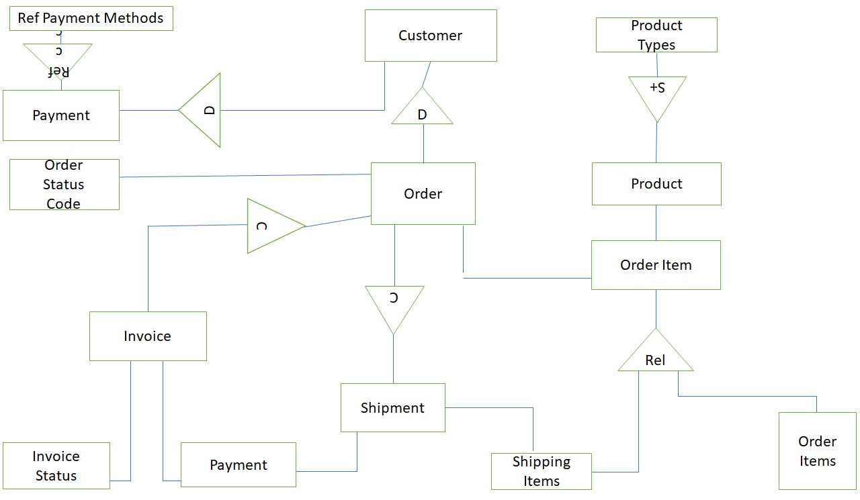
Graphical Representation

Slide 13
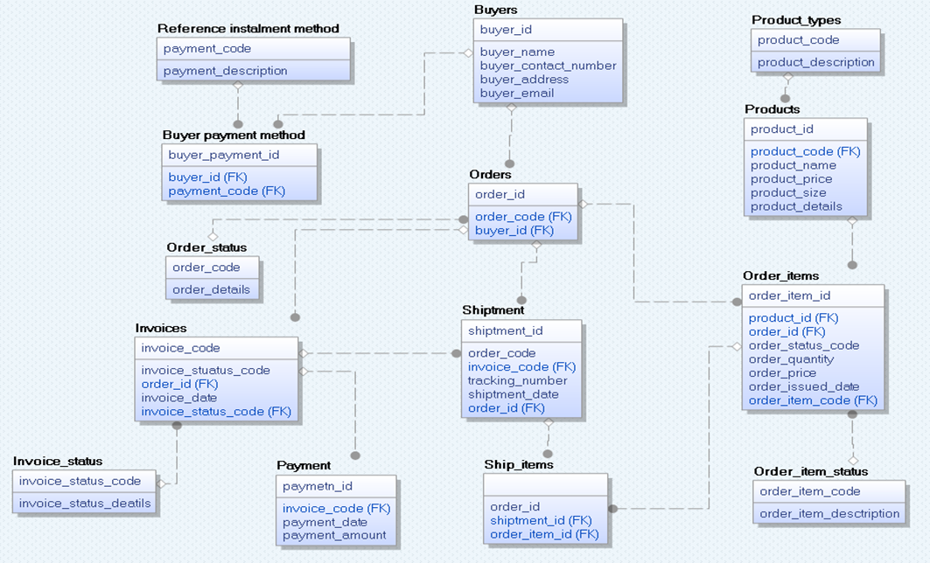
Data Model

Slide 14
Business Rules
• Customer_id can have multiple names, addresses, and phone numbers but only one account name and email
• There are different payment_codes as there are different methods of paying, yet only one payment
• The product_id does not need always need a size or price, as certain products may be one size only or not be in stock and the price will fluctuate The order item can not be processed unless the item has an order_item_id
• The order_status is dependent on the payment method and if it was accepted, as well as external factors revolving around shipping and mail services
• Buyer_ID affects the order status and shipping as a user may have Prime or a regular amazon account
• The invoice is dependent upon the order items list quantity number of an item depends on both customer preference and store stock

Slide 15
E-commerce business models
•An eBay is an internet business that can work as the computerized arm of a retail goliath or an actual store. It can likewise be a solitary individual selling makes out of their home through internet-based commercial centers.
•Obviously, there's an entire reach between those limits. eBay models fluctuate generally and incorporate numerous business types.
•eBay is the purchasing and selling of various products over the web.
•eBay can sub for physical stores, however, a few organizations decide to keep up with both.
•Nearly anything can be bought through eBay today.

Slide 16
Different types of ecommerce businesses:
Business-to-business (B2B) :
B2B e-commerce refers to when a company purchases goods or services online from another enterprise. Some examples include a restaurant buying an ice machine or a law firm purchasing accounting software.
Business software like customer relationship management (CRM) platforms and payment processing companies are considered to be B2B, too.
Business-to-consumer (B2C) :
B2C online retail happens when a consumer purchases an item over the internet for their own use. Although B2C e-commerce seems more prominent, it’s only about half the size of the worldwide B2B e-commerce market.
Consumer-to-consumer (C2C) :
C2C operates like a digital yard sale or an internet auction in which individual people sell goods to each other. These might be products they make, such as handcrafts or art, or second hand items they own and want to sell.

Slide 17
Consumer-to-business (C2B) :
Consumer that creates value for a business is considered as Consumer to Business (C2B).
For example,, C2B can be as simple as a customer giving feedback for a business or a stock photography website purchasing images from freelancers. In addition, businesses that sell secondhand products sometimes purchase merchandise from private citizens online.
Business-to-government (B2G) :
These are also known as business-to-administration (B2A) sales.
Business to government (B2G) is the sale and marketing of goods and services to federal, state, or local agencies.
For example, a custodial firm might bid online for a contract to clean the county courthouse, or an IT firm might reply to a proposal to manage a city's computer hardware.
Consumer-to-government (C2G)
This model indicates the transactions between government and consumers. where consumer provides any services or feedback that adds value to the government administration or authorities. It is an electronic platform where consumers interact with the government.

Slide 18
Contract for purchasing a Product

Slide 19
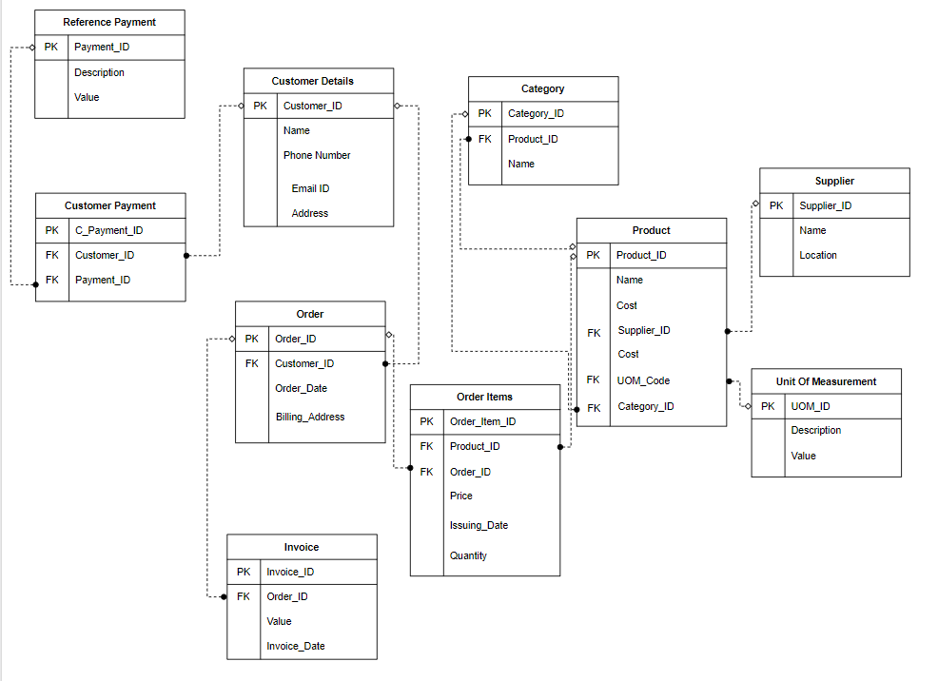
Model

Slide 20
Invariants:
Proper Details of Customers must be present in the database.
All the details of the customer must be genuine.
Preconditions:
Customer needs to Login with their credentials.
Minimum order for shipment is $25.
Customer selects the appropriate Product ID, name and description.
Initially, shopping cart is empty; thereafter, customers can add products depending on their requirements.
Items which are available in stock can be added to the cart.
PostConditions:
Customer’s shopping cart has (n) item(s) in it.
The customer is billed at the billing counter.
Invoice is generated after successful transaction.
Shipping information is processed.
Stock reduced by item quantity purchased
Triggers:
Customer logs in to the account and looks for products as per the need and sets up the order

Slide 21
Contract for delivery of order

Slide 22
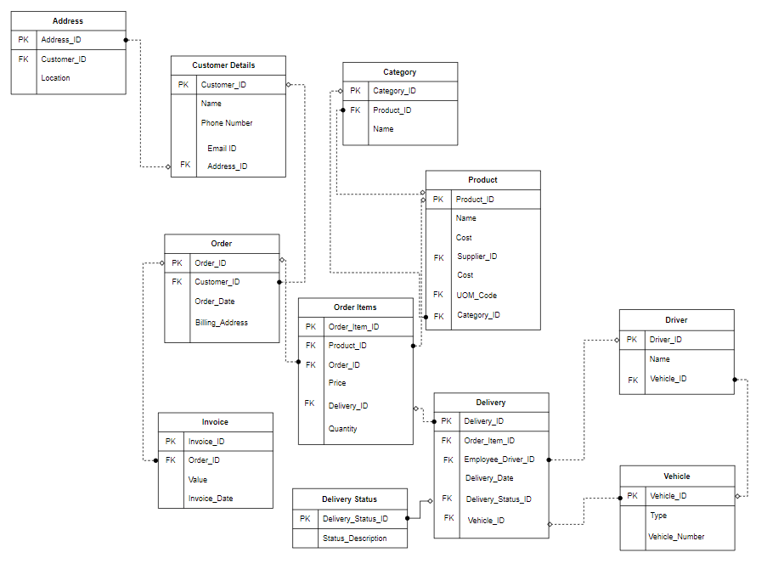
Model

Slide 23
Invariants
All the personal details of the customers must be present.
All the details of the customer must be legit for the delivery of the order placed by the customer.
Preconditions:
Minimum order for shipment is $30.
Delivery address is required for the delivery of the order placed by the customer. Customer must specify the payment method, he/she opts for the payment of the order.
The shopping cart is empty.
The item should be available in stock for placing the order.
Postconditions:
The shopping cart has (an) item(s) The customer is billed.
Shipping information is processed Customer gets delivery status report.
Customer is delivered the required order.
Trigger:
After adding a product or products to cart, order is placed for payment & delivery

Slide 24
Contract for purchasing a New Service

Slide 25
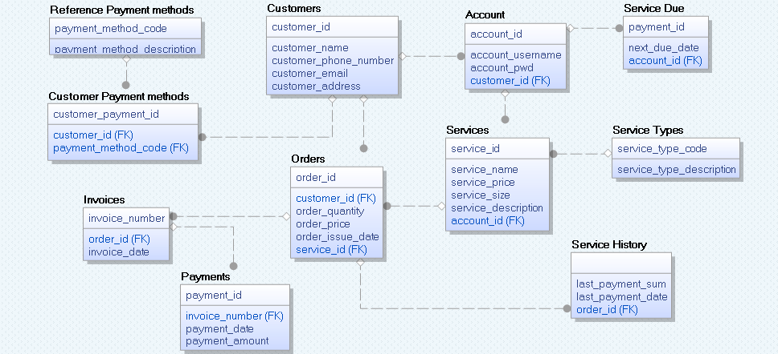
Model

Slide 26
Invariant:
All the personal details of the customers must be present
All the details of the customer must be legit
Every service has cost, service type, size, and description
PreConditions:
Login with username and password
Product ID, Product names, Product descriptions depend on the selection of the product by the customer.
Order ID, order quantity and order description depends upon the selection of the different products by the customer
Invoice does not exist
A customer can have no service or pre-existing service

Slide 27
Post-Conditions:
An Invoice is issued monthly
The payment method is registered and used automatically at the end of the month
A service history is created for the customer for services selected and purchased
A payment is automatically deduced from the customer’s account
A customer has a new service
Trigger:
Customer looks for various services, selects a service and places it in the cart.

Slide 28
Conclusion
Ebay has developed a distinct and important business strategy that has allowed it to expand its ecommerce operations. The corporation handles everything, including shipping, while the sellers are solely responsible for advertising their products and services.
Due to its creativity, appropriate use of technology, management, and other factors, ebay has been assessed to be the most profitable and efficient e-retailer.
Leadership on a global scale, low costs, large margins, limitless inventories, and exceptional customer service.
Online buying is reshaping the retail industry, replacing traditional advertising and in-store customer care with a more convenient purchasing experience.
In the retail industry, e-commerce has shown to be the most cost-effective change. Ebay's ER model, on the other hand, depicts the whole ecommerce system.

Slide 29
THANK YOU

